Slide 1

Silicon Institute of Technology, Sambalpur
Project Presentation
Department : ECE
Date : 10th February 2023

Slide 2
Covid Relief Bot using Microcontrollers
Supervised by
Mr. Nabin Kumar Naik
Sr. Assistant Professor
ECE
Dr. Manas Ranjan Jena
Assistant Professor
ECE
Presented by
Aniket Shukla, Gourish Bhagat, Kiran Jyoti Pujari, Nivedita Tripathy
1901341039,1901341040,1901341041,2021341015
ECE

Slide 3
Literature Review
We study the existing papers on “Robots under COVID19 pandemic” and “Humanoid robot's applications in COVID19 ”.
While reading these papers we came to find out that none of these bots where capable of running by their own and they require a human guidance. Also, they were used for testing covid and for cleaning and sanitization purpose.
We wish to Create a research on a robot that was capable of running by its own and can be used to deliver medicine and foods to a infected person.

Slide 4
Motivation
During the pandemic, the whole world halted and were looking for ways to reduce the infection from spreading more and the ones who were infected were isolated from others.
This made it tough for doctors and nurses globally to treat their patients and get them medicines and food. For this, they had to wear a complete PPE kit every time to check the infected person.
Therefore, to help doctors and the infected person get his medicines and food, we decided to make a bot that could run automatically in a room of covid patients.
This will reduce the direct contact of a covid, or infected persons contact with a non-infected one.

Slide 5
Objective
To Provide medicines and food in the isolated wards.
To help those people who are recovering in their respective homes.
To protect the spread of disease.
Use of handy Robots in the day-to-day life.
To get a Robot in a minimal rate or affordable price.

Slide 6
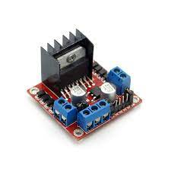
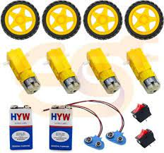
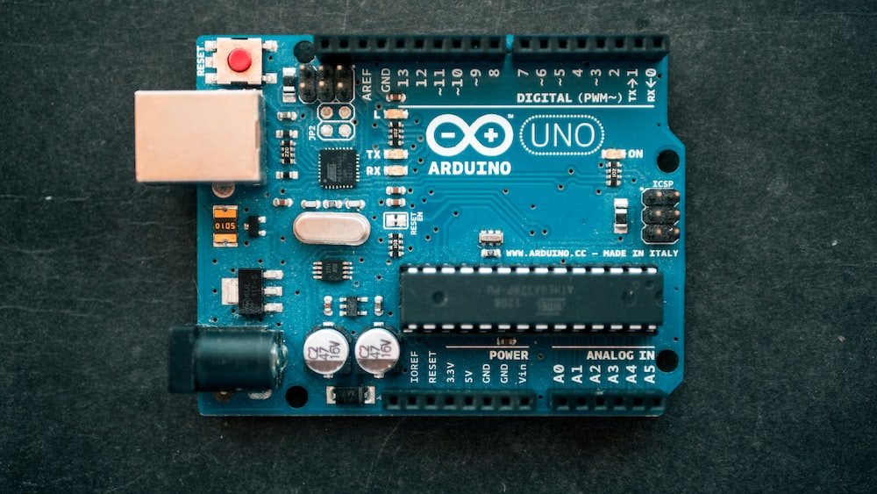
Methodology
To build the bot we used some electronic items like Arduino, Motor Drivers, BO batteries, Jumper Wires. We also designed the track on which the bot runs using Adobe illustrator whose size is of the ratio 4:8 and has a 3.5 cm thickness which we got printed.

Slide 7
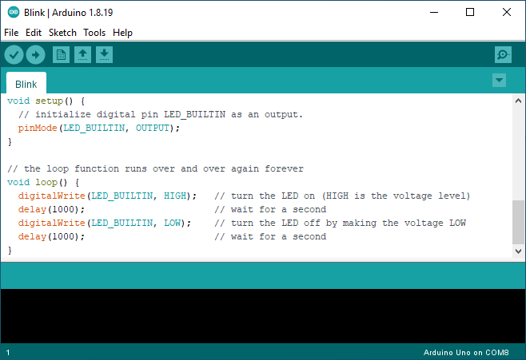
To code the Arduino, we used Arduino software.
For sensing purpose, we used Infrared Sensor which distinguishes white and black lines and sends response to the Arduino.

Slide 8
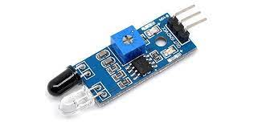
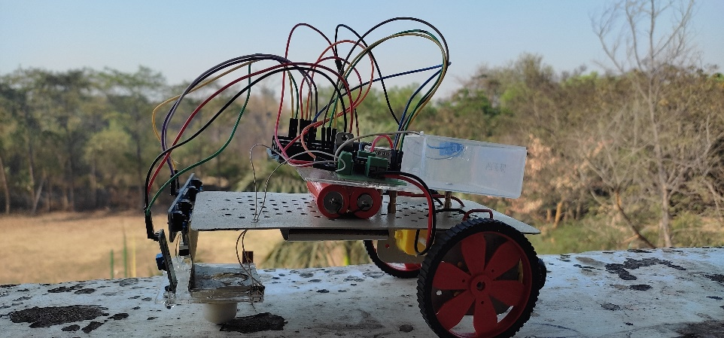
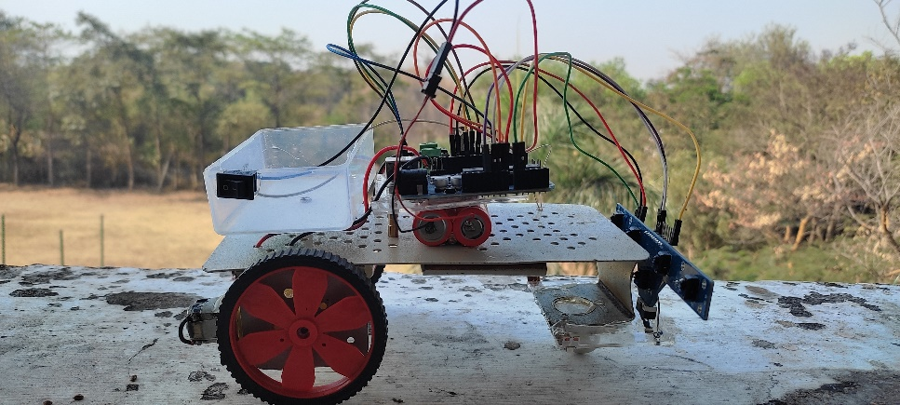
And finally, we connected all electronic items with the help of jumper wires and designed a Chassis for the bot. This chassis contains a box to hold the medicine and other items.
For the chassis material, we used aluminium sheets. These sheets were cut in a design we considered and created area to place the items used.

Slide 9
Roadmap
We analysed the problem faced by current technologies and need for our bot.
We then gathered methodology that can be used for building the bot.
Then, we worked on arranging the components used.
We took an aluminium sheet and cut it into a size of 18cm * 10cm.
After which, we designed area for placing other Electronics components.
We attached wheels and the motor drivers with the help of Glue gun and connected 2 BO motors.

Slide 10
Then, we connected motor driver with batteries and Arduino at the pin number 8,9,10.
The batteries act as a source of power for the Arduino and the pin connection gives bot the commands as coded in the Arduino.
The Arduino is then coded with the help of Arduino software. To connect the laptop with Arduino we use a USB cable and then we upload the code in the Arduino.
Now as we have the Arduino coded, we connect Arduino with sensors and use 5V and ground to complete the connection.
Then, we created a platform for carrying the medicine.

Slide 11
Once the bot was completed, we started working on our floor.
The floor we designed displays a hospital room and it consist of a Straight line at the centre which represents a path for our Bot to follow.
For understanding purpose, we consider a patient sitting in a chair at the end of line and then show you a practical demonstration of how our bot will deliver the medicines
We have created a basic model of our project just to elaborate the working mechanism of the bot. We have been testing it for smaller rooms for now and also implemented some updates like controlling the bot using mobile phone with a Bluetooth connection.

Slide 12
References
[1] Pakdaman, Sanaatiyan, M.M.,"Design and Implemen tation of Line Follower Robot,", Second International Conference on Computer and ElectricalEngineering TCCEE '09, vol.2, pp.585-590, Dec.2009.[
2] PriyankPatil,"AVR Line Following Robot,” Department of Information Technology K. 1. Somaiya College of Engineering Mumbai, India. Mar 5, 2010.
[3] Dean A. Pomerleau; Jay Gowdy; Charles E. Thorpe, “Combining Artificial Neural Networks and Symbolic Processing for Autonomous Robot Guidance,"Engng Applic. Artif. Intell. Vol. 4, No. 4, pp. 279-285, 1991.
[4] L1U Shi-Cai,L1U Guang-Jun, "Formation Control of Mobile Robots with Active Obstacle Avoidance," Acta Automatica Sinica, Vol. 33, No. 5,2007.
[5] YANG Tian-Tian; L1U Zhi-Yuan; CHEN Hong; PEl Run, "Formation Control and Obstacle Avoidance for Multiple Mobile Robots," ActaAutomatica Sinica, Vol. 34, No. 5, 2008.

Slide 13
Thank You

